Slide 1

Bioinformatics Bootcamp
Beginner Workshop: “R for Biologists”
Module 1: Orientation and Setting up R

Slide 2
Workshop Orientation

Slide 3
Why a workshop?
Those who know bioinformatics will be…
More effective at research
More competitive for jobs/funding
More flexible/adaptable to changes in their field
There is tremendous interest in formal bioinformatics training... yet, opportunities for such training are sparse.
Solution: Provide training as a weekly workshop open to all!

Slide 4
Workshop Structure
Most sessions will be roughly 50:50 lecture and hands-on activities.

Slide 5
Workshop Structure
Most sessions will be roughly 50:50 lecture and hands-on activities.
***Lectures will be recorded***

Slide 6
Workshop Structure
Most sessions will be roughly 50:50 lecture and hands-on activities.
***Lectures will be recorded***
Outline
Module 1: Orientation and setting up R
Module 2: Data structures in R
Module 3: Fundamental programming concepts in R
Module 4: Review week
Module 5: The Tidyverse
Module 6: R for biological data science

Slide 7
Learning goals and objectives
From this workshop, you will learn the following topics:
Data structures
Plotting
Reading/writing files
Conditional logic & control flow
Function definitions
Data processing pipelines with tidyverse

Slide 8
Learning goals and objectives
From this workshop, you will learn the following topics:
Data structures
Plotting
Reading/writing files
Conditional logic & control flow
Function definitions
Data processing pipelines with tidyverse
By the end, you will gain the skills and confidence to use R in your research.

Slide 9
How to succeed in this workshop
Complete the assignments in DataCamp

Slide 10
How to succeed in this workshop
Complete the assignments in DataCamp
Pursue outside learning (e.g., codecademy, RStudio books, etc)

Slide 11
How to succeed in this workshop
Complete the assignments in DataCamp
Pursue outside learning (e.g., codecademy, RStudio books, etc)
Communicate with your instructors
Email any time and attend Zoom office hours (listed in the syllabus)

Slide 12
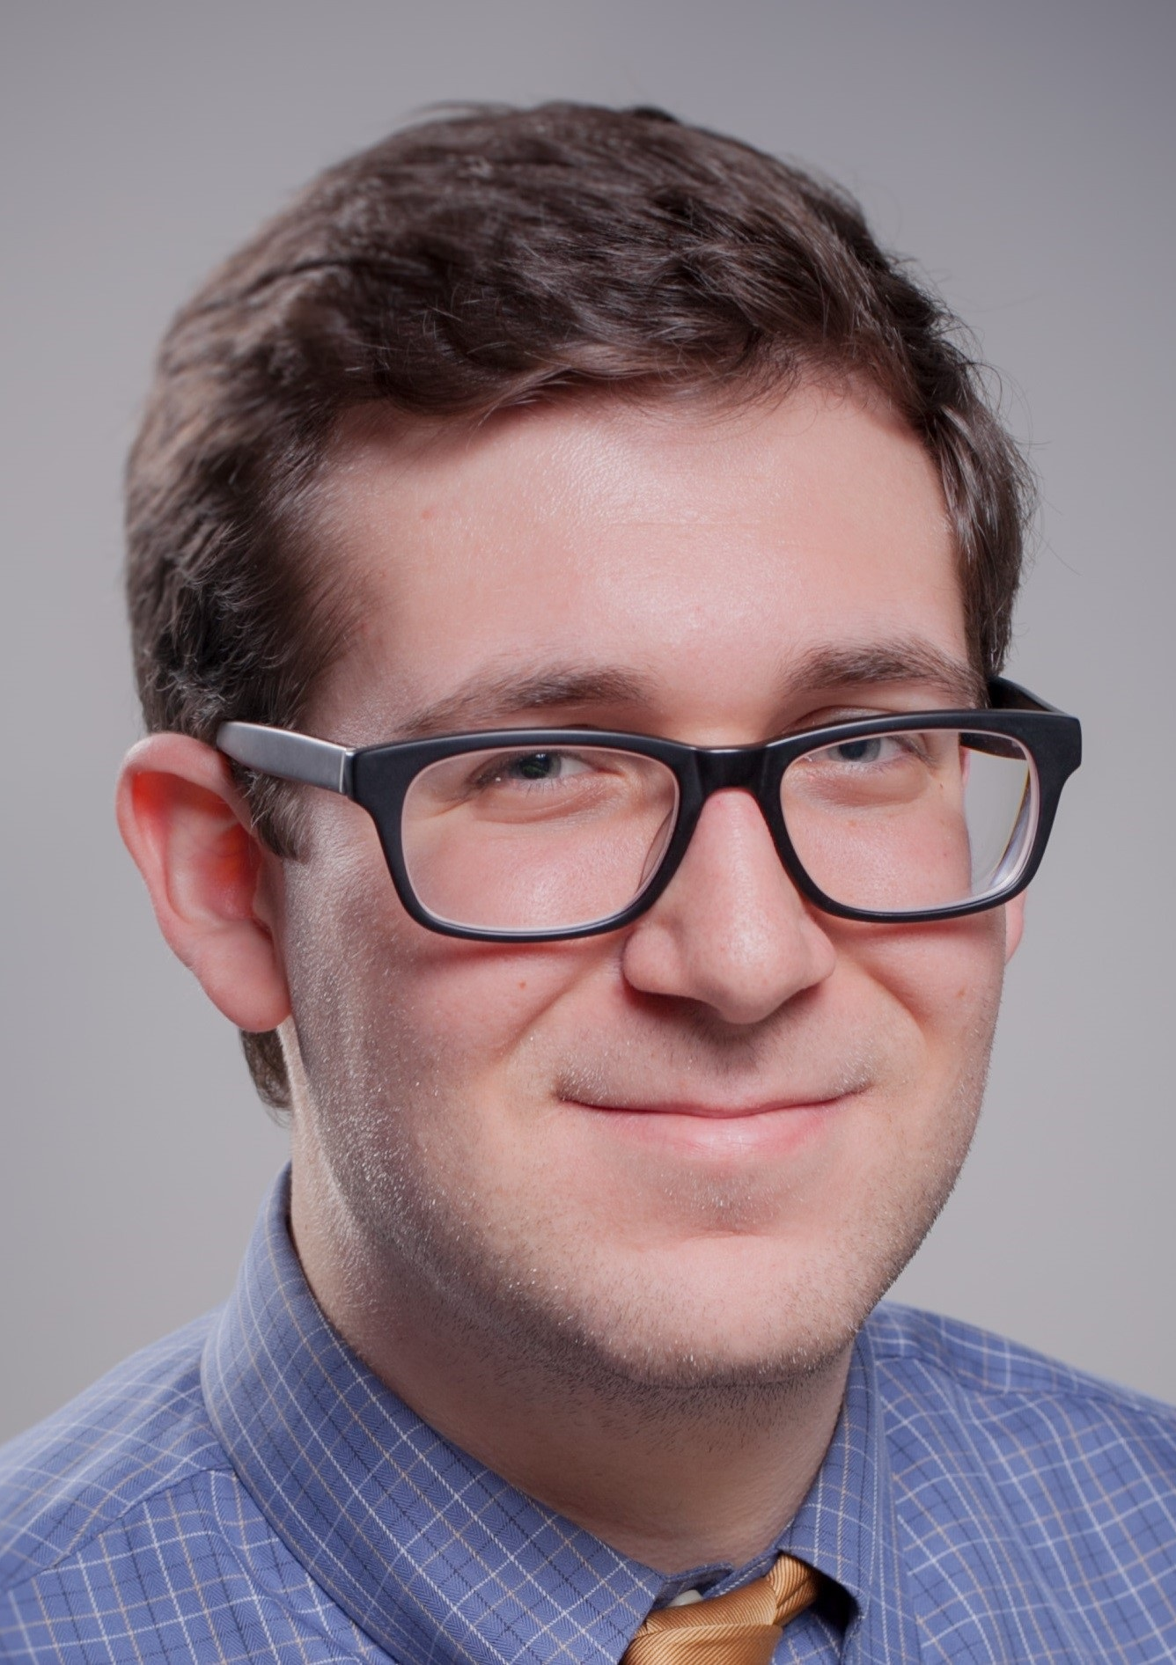
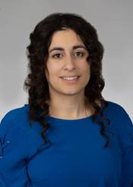
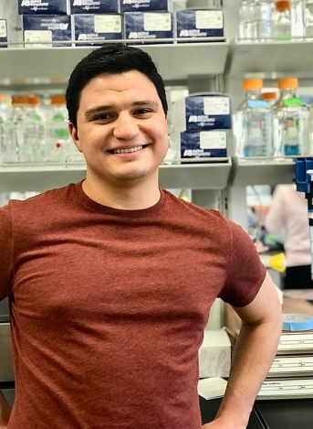
Bioinformatics Bootcamp Instructors
Henry Miller
Simon Levy
Aiola Stoja

Slide 13

About BIG club
Bioinformatics Interest Group (BIG) is a new UT Health SA club promoting student engagement with bioinformatics.
Leadership
President: Muku Bhandari
Vice President: Victoria Alers
Secretary: Paul Ramirez
Training committee chair: Henry Miller
Historian: Aiola Stoja
Treasurer: Meilinn Tram
All UT Health SA students are welcome to join our first meeting next Tuesday Sept 8th from 6:30-7:30pm.

